Slide 1
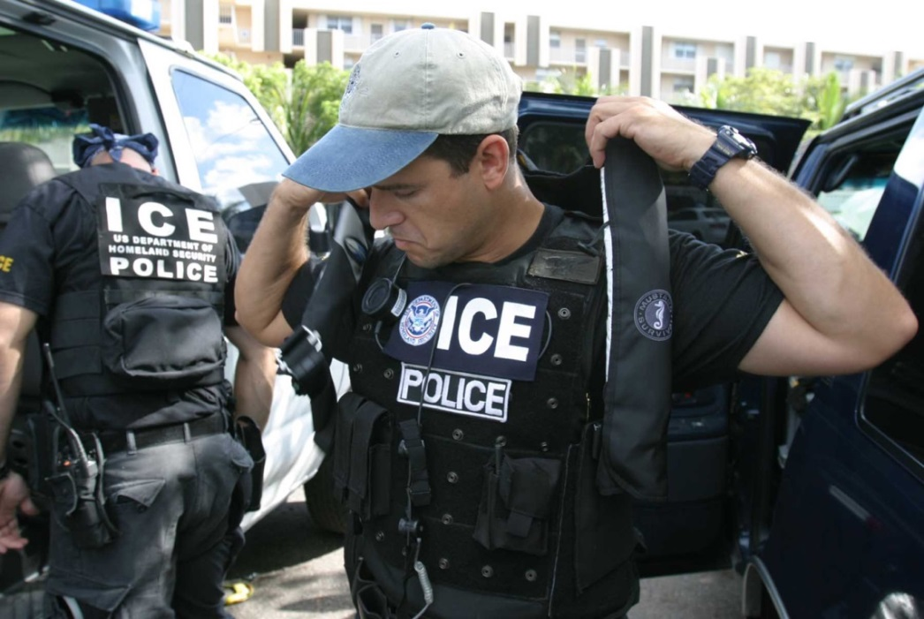
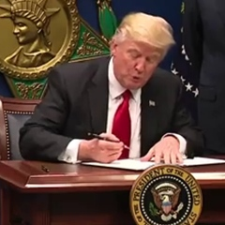
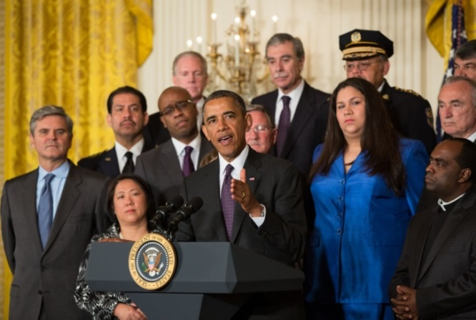
Immigration Enforcement and Rights
Notes:
This presentation is current as of September 8, 2017.

Slide 2
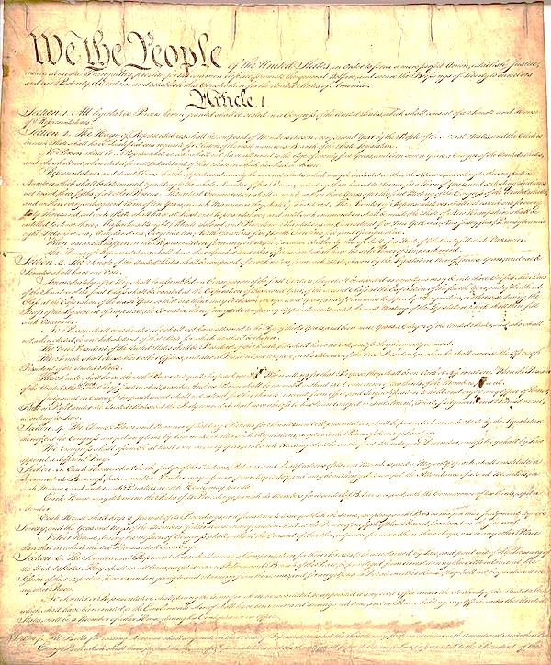
What does the Constitution say about immigration?
Article I of The U.S. Constitution gives Congress the power to regulate naturalization. That is: who can become a citizen. Under this power, over the years, Congress has passed a number of laws regulating immigration.
Article II of the Constitution defines the powers of the President. Among those is the authority to enforce the laws of the United States, conduct foreign affairs, and assure national security.
Article III of the Constitution establishes a Supreme Court. The Supreme Court has determined that the regulation of immigration belongs to the federal government, not the states, and that Congress can delegate powers to regulate immigration to the Executive Branch and the president.
Notes:
[Click] for each of the three articles (I-III) of the Constitution.
Explain that the Constitution does not explicitly mention immigration, but each branch of our government has certain powers that affect immigration to the United States.
This presentation is current as of September 8, 2017.

Slide 3
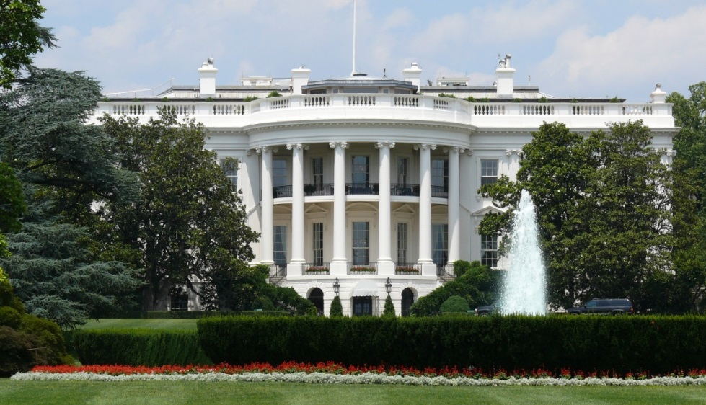
The President’s Power
Through time, Congress has delegated immigration authority to the Executive Branch.
Notes:
For example, explain to students that today the president can:
determine whether a non-citizen can work in the United States,
grant a person who does not have a valid visa permission to be in country, or
decide whether to defer action on people subject to deportation.
This presentation is current as of September 8, 2017.

Slide 4
Different Presidents,
Different Immigration Policies
President Obama used executive branch immigration powers to place restrictions on immigration enforcement.
And he established the DACA program, which you will learn more about in a few minutes.
Notes:
Explain to students that nearly 3 million undocumented people were deported during President Obama’s presidency. However, he also used executive branch immigration powers to place restrictions on immigration enforcement.
The DACA program deferred deportations of undocumented young people.
This presentation is current as of September 8, 2017.

Slide 5
Different Presidents,
Different Immigration Policies
President Trump wants to use his powers to reverse many of Obama’s policies.
He has made immigration enforcement easier.
Notes:
Explain to students that President Trump believes there are too many undocumented people in the country.
He has increased the number of people who can be deported by “expedited removal.” On September 5, 2017, he issued an executive order rescinding the DACA program.
This presentation is current as of September 8, 2017.

Slide 6
President Trump’s Enforcement Priorities
On January 25, 2017, the president signed executive orders prioritizing border security and immigration enforcement, including:
A wall along the southern border of the United States.
Increasing immigration law enforcement.
New immigration detention facilities.
Reducing the number of paroles.
Detaining undocumented immigrants.
Notes:
Explain to students that these priorities are broad. For example, a policy to detain anybody “apprehended on suspicion” of violating immigration laws will increase the number of people in detention.
Describe these details to students about the executive orders:
Immediate construction of a “physical wall” along the southern border of the United States.
Hiring 5,000 new Border Patrol agents and 10,000 more immigration officers in the U.S.
Construction of immigration detention facilities near the U.S.-Mexico border.
Reducing the number of paroles. A parole in this context means the government’s permission to allow undocumented immigrants to stay in the country for humanitarian reasons. (Not to be confused with the use of “parole” in reference to incarceration.)
Detaining undocumented immigrants apprehended on suspicion of violating laws, including immigration law.
If time permits, tell students about other orders not listed on the slide: cutting funding to so-called “sanctuary cities;” creation of the “Office for Victims of Crimes Committed by Removable Aliens;” reviving the “Secure Communities” program ended under Obama administration to require local law enforcement to share arrest data (e.g., fingerprints) to help capture undocumented immigrants; and using sanctions by the Dept. of Homeland Security against nations that do not cooperate with the U.S. in taking back their own nationals who are deported from the U.S.
This presentation is current as of September 8, 2017.

Slide 7
President Trump’s Enforcement Priorities (cont’d)
In another order, the president prioritized removal (deportation) of immigrants who:
Have been convicted of any criminal offense.
Have pending criminal charges.
Have committed acts that would be a crime.
Have committed fraud before a government agency.
Have abused public benefits programs.
Have a final order of removal.
Are deemed to be a “risk to public safety or national security” by an immigration officer.
Recent guidelines also suggest potential targeting of the family members of unaccompanied minors.
Notes:
Tell students: These priorities are EXCEEDINGLY broad.
Relatives of unaccompanied minors - may be at risk for both immigration enforcement and criminal prosecution if gov’t can prove connection to smuggling.
This presentation is current as of September 8, 2017.

Slide 8
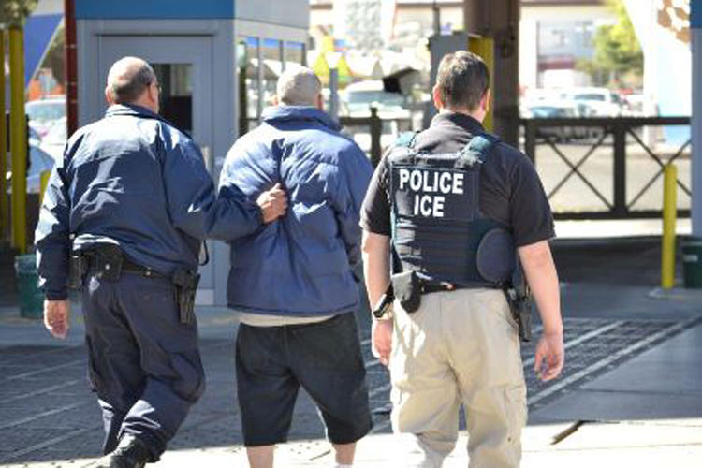
President Trump’s Enforcement Priorities (cont’d)
Expedited Removal:
Issued by an ICE officer, not a judge.
Under Trump this applies to a person:
1) who lacks entry documents or 2) who received entry or immigration documents via fraud,
Who could not prove physical presence for the past two years,
Anywhere in the United States.
Notes:
Explain to students that expedited removal means removal proceedings that are “sped up” or moved to the top of ICE’s task list. Under Obama, this applied to those who could not prove physical presence in the U.S. for 14 days and who were apprehended within 100 miles of the U.S. border.
The interior enforcement executive orders attempt to expand the use of expedited removal:
Issued by an ICE officer, not a judge.
Under Trump this applies to a person:
1) who lacks entry documents or 2) who received entry or immigration documents via fraud,
Who could not prove physical presence for the past two years,
Anywhere in the United States.
[Click] to reveal whom expedited removal applies to.
This presentation is current as of September 8, 2017.

Slide 9
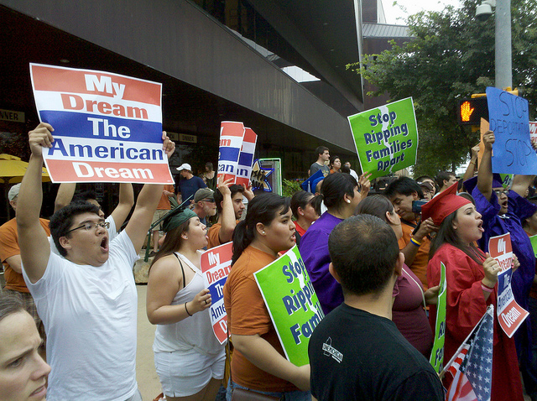
Back to DACA . . .
DEFERRED ACTION FOR CHILDHOOD ARRIVALS:
Executive policy created by President Barack Obama in June 2012.
DACA gives certain immigrants brought to the United States as children two-year work permits.
President Trump rescinded the DACA program on September 5, 2017.
Notes:
In the five years that DACA was in effect, nearly 800,000 individuals received protection against deportation under DACA.
Tell students that when it comes to DACA, advocates generally recommend:
First-time applicants should apply only after consultation with an experienced immigration attorney.
Renewals should be submitted only for persons with no criminal history.
No DACA recipient should leave the country at this time.
All DACA participants should consult with a lawyer before taking any action with respect to DACA, whether it be a first time application, a renewal, or travel.
This presentation is current as of September 8, 2017.

Slide 10
The End of DACA?
As of September 5, 2017, the Department of Homeland Security:
Will not process new DACA applications, and
Will renew on a case-by-case basis DACA permits for anyone whose status expires within six months of September 5.
President Trump announced that the six-month delay is intended to give Congress time to pass DACA as a law, not to continue it as an executive order.
“It is now time for Congress to act!” he said.
Notes:
According to the U.S. Citizenship and Immigration Services (USCIS), which is part of the Dept. of Homeland Security:
As of September 5, 2017, individuals who currently have DACA will be allowed to retain both DACA and their work authorizations (EADs) until they expire.
USCIS will adjudicate, on an individual, case by case basis:
- Properly filed pending DACA initial requests and associated applications for employment authorization documents (EADs) that have been accepted as of Sept. 5, 2017.
- Properly filed pending DACA renewal requests and associated applications for EADs from current beneficiaries that have been accepted as of the date of President Trump’s ending the program, and from current beneficiaries whose benefits will expire between Sept. 5, 2017 and March 5, 2018 that have been accepted as of Oct. 5, 2017.
Individuals who have not submitted an application by Sept. 5, for an initial request under DACA may no longer apply. USCIS will reject all applications for initial requests received after Sept. 5.
This presentation is current as of September 8, 2017.

Slide 11
Everyone in the United States – regardless of immigration status – has certain basic rights under the United States Constitution.
Everyone has:
The right to remain silent.
The right to privacy.
The right to an attorney.
The right to due process.
Let’s take a closer look at each of these . . .
Let’s take a closer look at each of these . . .
Notes:
[Click to reveal]:
Let’s take a closer look at each of these...
This presentation is current as of September 8, 2017.

Slide 12
The Right to Remain Silent
How can a person exercise the right to remain silent? When questioned by law enforcement, a person can:
refuse to answer questions until he or she has a chance to consult with an attorney.
choose not to speak at all.
decline to share information about where he or she was born or how he or she entered the United States.
carry a “know your rights” card and provide it to immigration officers if stopped.
Notes:
Explain to students that the right to remain silent is important because admission of alienage (being a foreigner) can be used as proof against someone in removal proceedings.
False documents can open someone up to criminal charges – Lawyers advise it is VERY important that NO ONE carry them.
This presentation is current as of September 8, 2017.

Slide 13
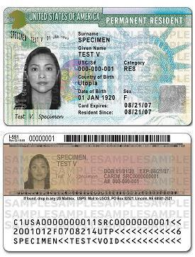
What About
Immigration Documents?
Lawyers advise immigrants to carry valid immigration documents regarding legal status in the United States at all times.
Examples include:
Lawful permanent resident card (green card)
Proof of asylum status
Proof of pending immigration applications
Notes:
Explain to students that NO ONE should EVER carry false documents, as it risks criminal charges. Pictured: An example of a green card.
ICE may keep any documents found on someone’s person.
This presentation is current as of September 8, 2017.

Slide 14
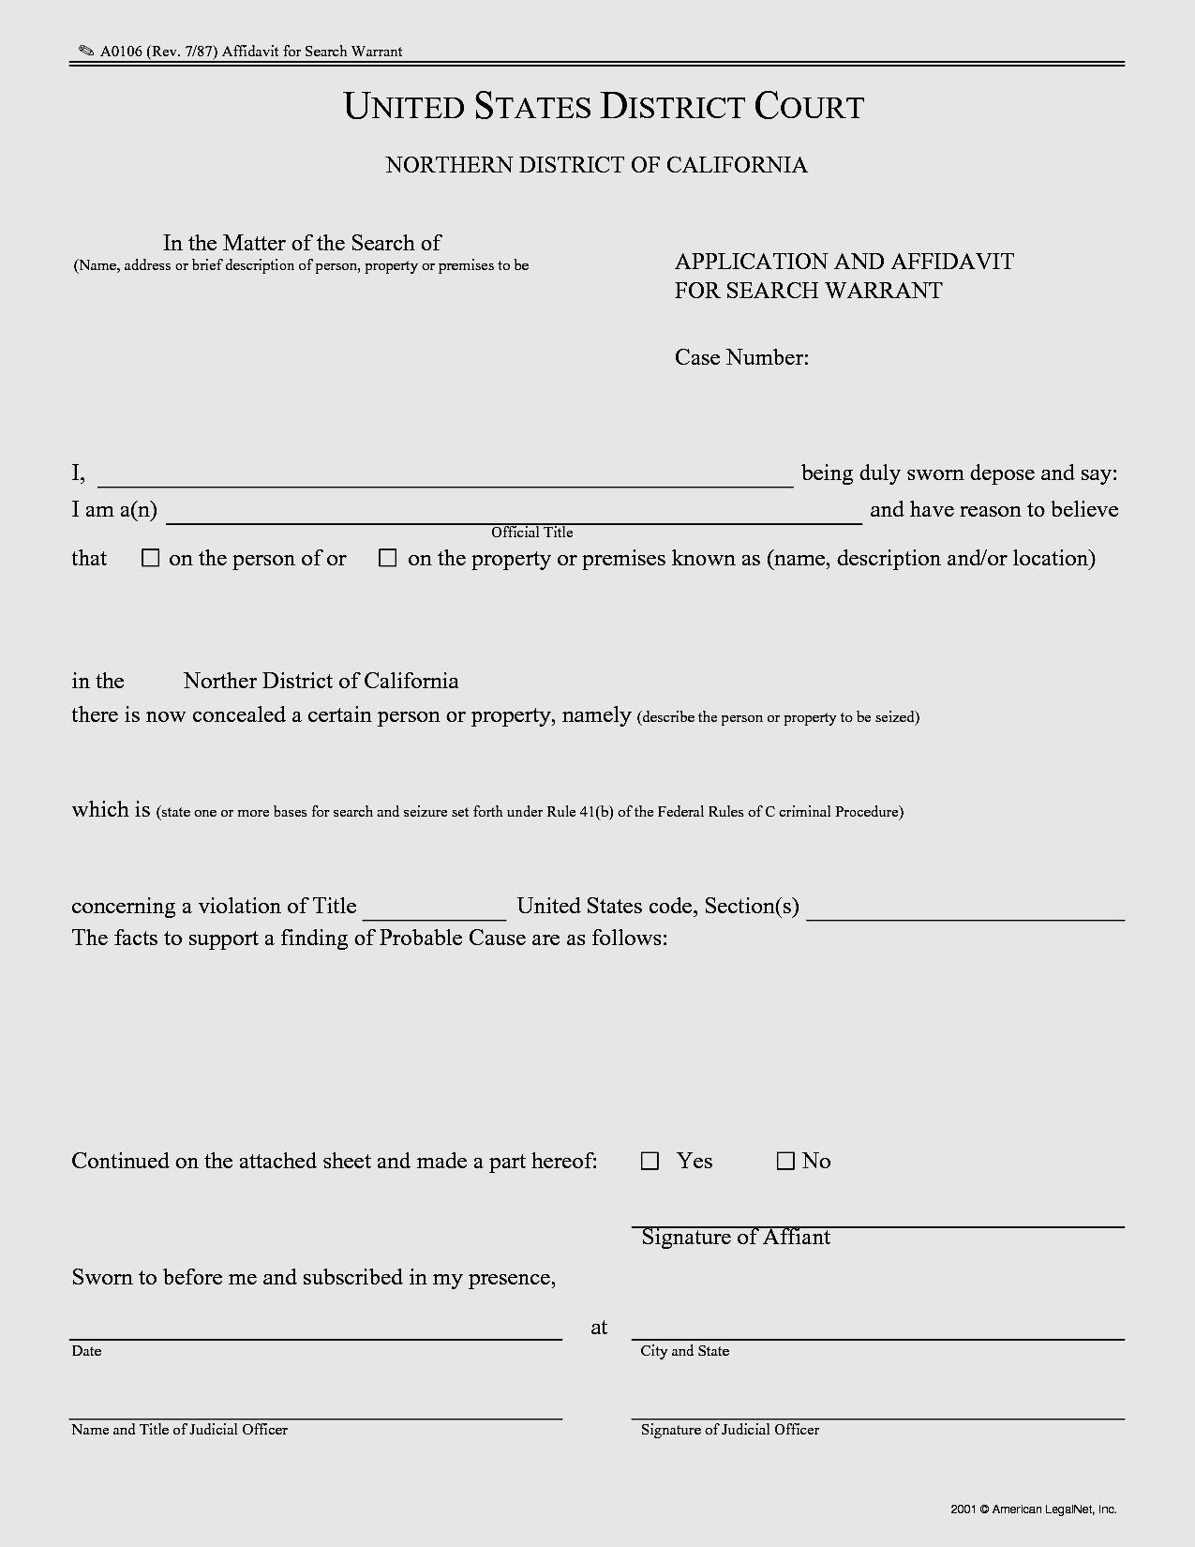
The Right to Privacy
No one has to open their door to any law enforcement agency– including ICE– unless a judge has issued a search warrant.
Notes:
Explain to students that under the Fourth amendment to the Constitution, a search warrant must issue from a judge and not from ICE or any other law enforcement agency. Warrant exceptions exist under certain “exigent circumstances” (such as “hot pursuit” of a suspect who is fleeing ICE agents into a home).
ICE arrest warrants are valid ONLY in public and not as a means to gain entry into anyone’s home.
This presentation is current as of September 8, 2017.

Slide 15
The Right to Privacy
If ICE comes to an immigrant’s home, he or she does not have to open the door unless ICE agents show a valid search warrant.
To be valid, a warrant must include both the resident’s name and address. The warrant must also be issued by a court and signed by a judge.
Notes:
Notes for presenter:
If ICE comes to an immigrant’s home, he or she does not have to open the door unless ICE agents show a valid search warrant.
The resident in the home can ask the agents to slide the warrant under the door or hold it up to the window.
ICE usually appears at homes with administrative warrants signed by their own officers. These warrants are not issued by a court and are not signed by a judge. Advocates advise that no one is obligated to open the door for an ICE officer presenting an administrative warrant.
This presentation is current as of September 8, 2017.

Slide 16
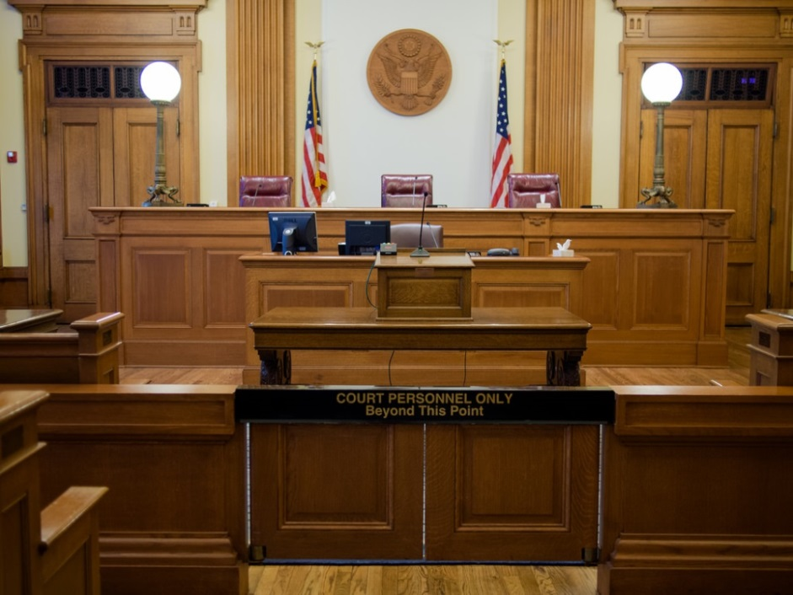
The Right to an Attorney
Immigrants facing removal have the right to an attorney (but not at government expense).
For example, anyone with an attorney has the right to have that attorney present when interviewed by ICE and in immigration court.
Notes:
Notes for presenter:
Immigrants facing removal have the right to an attorney (but not at government expense).
This means immigrants need to either pay a lawyer or find a lawyer who can represent them for free.
Anyone who has an attorney must be allowed access to that attorney.
California and L.A. are committing to funding immigrant representation, details are unclear but even the most expansive funding will likely fall short of the need in L.A.
As noted, notarios are not immigration attorneys. We’ll talk more about that in a moment.
Lawyers always advise that is a good idea to talk to a lawyer before signing any immigration paperwork.
This presentation is current as of September 8, 2017.

Slide 17
The Right to Due Process
Immigrants have the right to fair court procedures in removal proceedings.
This includes:
the right to an attorney,
the right to present evidence,
the right to translation in the courtroom,
and the right to cross-examine witnesses.
Many immigrants placed in deportation proceedings will have the right to go before a judge who will determine whether they can remain in the United States.
Notes:
Explain to students that this is a little bit technical, but important for everyone to know that they have a right to a hearing. DUE PROCESS means “due process of law,” or notice (a warning or announcement) of a hearing and a hearing itself (deportation proceeding before an impartial hearing officer). Due process means a fair process.
Lawyers advise it is VERY important for the people who don’t know they have old removal orders to know about the rights listed here.
About the right to an attorney, remember what we just discussed. The government does NOT have to provide an attorney, but someone in a deportation proceeding does have the right to HIRE an attorney or to find one who will represent him or her for free (called “pro bono”).
This presentation is current as of September 8, 2017.

Slide 18
The Right to Due Process
EXCEPTIONS
If an immigrant has previously been ordered removed from within the United States and has not left the country, ICE may be able to immediately deport him or her using the prior deportation order.
If an immigrant was previously deported and then reentered the country OR is subject to the expanded expedited removal provisions, that person will only have a right to go before a judge after passing an interview about his or her fear of returning to the country of citizenship.
Notes:
Ask: Remember the expedited removal in President Trump’s January 25 order? That limits the right to due process as you can see here.
In the first exception shown here, the only likely way to try to evade removal is to file a motion to reopen with the immigration court that issued the removal order (if there is a basis for doing so). Strict time and numerical limitations apply to motions to reopen.
This presentation is current as of September 8, 2017.

Slide 19
Attorneys vs. Notarios
Immigrants seeking legal status are advised to always seek the help of an attorney, NOT a notary or notario:
Notaries in the United States are not authorized to practice law.
Notaries cannot accept money on behalf of an attorney.
Anyone who has previously been taken advantage of by a notario is advised to consult with an immigration attorney about options.
https://www.consumer.ftc.gov/features/feature-0031-fotonovelas
Notes:
Tell students that means a notary should never be representing anyone in court or arranging for someone to represent an immigrant in court.
This presentation is current as of September 8, 2017.

Slide 20
Immigration Enforcement and Rights
For more information on immigration history, policy, and current events and controversies, go to
crfimmigrationed.org
These materials are a production of
Constitutional Rights Foundation
in collaboration with
Public Counsel
© 2017 Constitutional Rights Foundation. All rights reserved.
Notes:
This presentation is current as of September 8, 2017.

Slide 21
Image Credits
All images used in this presentation are in the public domain EXCEPT:
“DREAM Act Protesters for President Obama's Visit to Austin” Todd Dwyer/flickr (Used with a CC BY-SA 2.0 license)
© 2017 Constitutional Rights Foundation. All rights reserved.
Notes:
This presentation is current as of September 8, 2017.

